Slide 1
9. IT and ethics
Do the right thing vs. Do things right
What are Ethical Principles?
How to Analyze IT Ethics?
Explain Network Neutrality.
Ethics Analysis of Blocking HTTPS
Taeha Kim, Professor in CAU Business School
Smart Business, Spring 2021

Slide 2
Class Management
1. Final Exam
Method: eClass Online Exam (assignment submission function), No Zoom Video Required
Time: Class Time 9:00 am – 10:30, June 11th , 2020
Details will be announced to [eClass][Announcements]
2. Zoom Meeting June 4th (last zoom meeting this semester).
3. Stay Safe and Healthy!

Slide 3
1. Ethical principles

Slide 4
Candidate Ethical Principles (1 of 2)
Golden Rule:
Do unto others as you would have them do unto you
Immanuel Kant’s Categorical Imperative:
If an action is not right for everyone to take,
it is not right for anyone.
Slippery Slope Rule:
If an action cannot be taken repeatedly,
it is not right to take at all
Notes:
Ensure that students understand the difference between the categorical imperative and the rule of change. Briefly, the difference is that the categorical imperative spans the entirety of the populace, whereas the rule of change applies to the decisions of one person over time. For example, the categorical imperative applies to an employee who tries to steal money from his employer. He shouldn’t do this, because if all employees attempted to do so, the company would fail. The rule of change applied to the same situation might run as follows: although the employee’s stealing one dollar from the company would not lead to any true problem, repeatedly stealing one dollar, or stealing a lot of dollars, would be unacceptable and ultimately lead to the destruction of the company.

Slide 5
Candidate Ethical Principles (2 of 2)
Utilitarian Principle:
Take the action that achieves the higher or greater value
Risk Aversion Principle:
Take the action that produces the least harm or potential cost
Ethical “No Free Lunch” Rule:
Assume that virtually all tangible and intangible objects are owned by someone unless there is a specific declaration otherwise
Notes:
How does the “no free lunch” rule relate to copyrights, patents, and trademarks? (These concepts are discussed in later slides.)
Explain that the appearance of unethical behavior is as harmful as actual unethical behavior at times, so adherence to these principles are critical. In an age of “open source software” how does the principle of “no free lunch” work out? Open source software is an example of an economic good which is licensed by the creator for distribution often without charge, or even attribution. In this case, there is a “free lunch.” But it occurs because the creators of the software consent to this arrangement.

Slide 6
IT Ethics Analysis
Who are Stakeholders?
Try to find Applicable Ethical Principle(s)
What is the Ethical Dilemma (conflict of interests)?
Role of IT in this problem

Slide 7
Book Thief vs. Stealing Intellectual Property
Intellectual Property Rights: Patent, Copyrights, Trademark, Trade Secret
Stealing book or DVD from bookstore:
Against Ethics
Against Law
CCTV or RFID Chip (IT)
Cyber Squatting (Nissan.com)
Copying PDF File illegally
Copying Mp3 without permission
Reproduce Software Package for free use without permission.

Slide 8
IT Ethics Analysis
Who are Stakeholders?
Creator, User, Distributor, …
Try to find Applicable Ethical Principle(s)
No Free Lunch? Golden Rule? Slippery Slope? Utilitarian Principle?
What is the Ethical Dilemma (conflict of interests)?
Students have no money to purchase SW, Books, Music, and so forth.
No Motivation of Creator without Strong Protection
Easy to reproduce the Digital Goods
Distributors lose money
Role of IT in this problem
Computers to reproduce digital goods in an efficient way (at Zero cost!)
Monitoring using DRM(digital rights management)

Slide 9
What if someone in your family used 70,000 dollars for Smartphone game?
WSJ Article: https://www.wsj.com/video/meet-the-man-who-has-spent-70000-playing-a-mobile-game/26634AF5-7C56-4D50-88B6-BF1AF0474346.html
(Same Contents) YouTube: https://www.youtube.com/watch?v=z-fxfuWhff0
Sony FATE/GRAND ORDER, Have you played?
Or Similar in Korean Games?

Slide 10
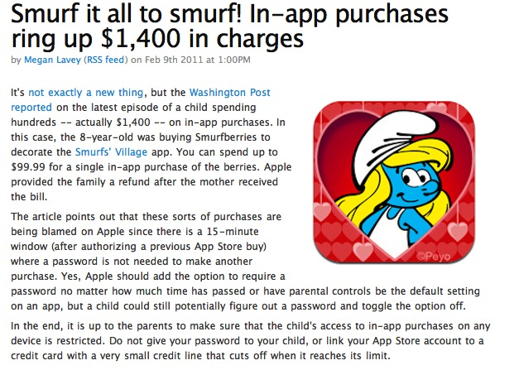
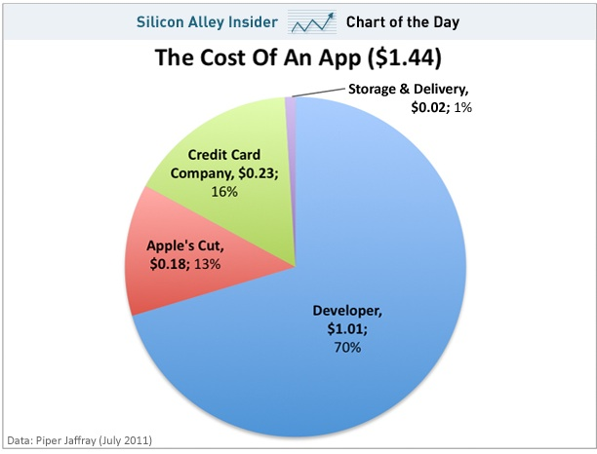
If your child spent 1400 dollars for Smartphone game in an hour?
https://www.digitaltrends.com/android/publisher-greed-little-girl-amasses-1400-iphone-bill-playing-smurfs-village/

Slide 11
IT Ethics Analysis
Who are Stakeholders?
Try to find Applicable Ethical Principle(s)
What is the Ethical Dilemma (conflict of interests)?
Role of IT in this problem

Slide 12
Business Implications?
Does IT strengthen/induce Unethical Behavior?
Or, does IT work in an opposite direction?
Is it a problem caused by IT or by People?

Slide 13
2. Network neutrality
Korean News:
https://youtu.be/txBR6et5CXU
https://youtu.be/CrK25yF0DtQ
American News:
https://youtu.be/hxz7PYlFvdI

Slide 14
IT Ethics Analysis
Who are Stakeholders?
Try to find Applicable Ethical Principle(s)
What is the Ethical Dilemma (conflict of interests)?
Role of IT in this problem

Slide 15
3. HTTPS Blocking vs. Privacy

Slide 16
Before Ethical Analysis, Get some inputs
(This contents are all Korean due to the location of happening)
Korean News: https://youtu.be/GDwKRvmUSyw
Not all sites are BAD: https://www.youtube.com/watch?v=74Sj92M6Xq4
Korean Government Response:
https://youtu.be/f5iIQiZ5zhc

Slide 17
IT Ethics Analysis
Who are Stakeholders?
Try to find Applicable Ethical Principle(s)
What is the Ethical Dilemma (conflict of interests)?
Role of IT in this problem

Slide 18
Summarizing Your thought?
1. Explain the relationship between IT and Ethics?
2. What is network neutrality and your opinion?
3. Try to perform Ethical Analysis of HTTPS Blocking.

Slide 19
